Slide 1
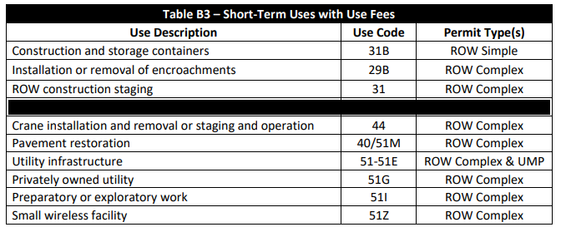
When use fees are applied
Non-transportation use types that incur use fees are shown below in the Table B3 from the Street Use Fee Schedule
Use types that incur use fees are only on the following record types:
  ROW Construction
  Heavy Crane
  Minor Utility
  Utility Major

Slide 2
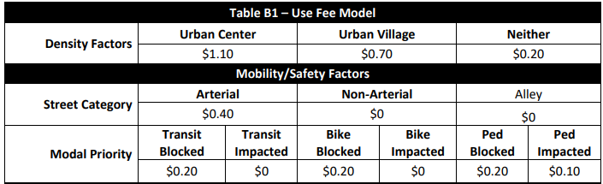
How use fees are calculated
The following variables influence use fees:
  Type of street (arterial vs. non-arterial)
  Location (Urban zones, residential etc.)
  Type of mobility impact (sidewalk, travel lane, alley etc.)
  Type of closure (closed, intermittent, reduced width etc.)
  Time in right-of-way (current use code table uses Duration + Work Days, but will be changing to Total Days in ROW)
  Duration of time in right-of-way (escalation rate = Rate Start Date)

Slide 3
How use fees are calculated – Mobility & Closure types in Accela
Mobility Type | Definition | Closure Type Options
Sidewalk Impact | Dedicated pedestrian zone including asphalt pathways | None Intermittent Closure Reduced Width Closed Rerouted
Bike Lane Impact | Dedicated striped and/or barricaded 24/7 bike lanes | None Intermittent Closure Closed Rerouted
GP Lane(s) Impact | General purpose travel lanes | None Reduced Width Intermittent Closure Some Lanes Closed All Lanes Closed
Transit Lane Impact | Dedicated striped 24/7 bus and other transit lanes | None Intermittent Closure Closed Rerouted
Parking Lane Impact | Dedicated paid or unpaid parking lanes | None Closed
Other ROW Impact | Any area not specifically listed (e.g., planting strip, gravel shoulder etc.) | Yes No

Slide 4
How use fees are calculated – Closure Types
Closure Type | Definition | Use Fees? | Additional Modal Priority Factor?
None | There is no impact to the chosen streetscape type and thus the public can use it as normal. | N | N
Intermittent Closure | Short-term (less than 5 mins) closures 3 times or less an hour to stop the traveling public using a flagger or UPO | N | N
Reduced Width (Equivalent to Impacted) | For sidewalks: partial sidewalk closure with at least a 4’ pedestrian pathway per ADA (or 8’ in Urban Centers) For GP lanes: reduced width travel lane while maintaining vehicular traffic per the Traffic Control Manual or as approved by Transportation Ops | Y | Y for sidewalks
Closed (Equivalent to Blocked) | Completely closed to the traveling public | Y | Y for sidewalks, transit lanes, and bike lanes
Rerouted | The traveling public has been routed to a different part of the streetscape on the same frontage. | N | N
All Lanes Closed | All general-purpose travel lanes on a frontage (one direction of travel for a 2-way road) are closed. | Y | N
Some Lanes Closed | Some general-purpose travel lanes on a frontage (one direction of travel for a 2-way road) are closed, but one or more lanes is still open for travel. | Y | N
Yes | There are impacts to an area not specifically listed under Other ROW (e.g., planting strip, gravel shoulder, filler etc.) | Y | N
No | There are no impacts to an area not specifically listed under Other ROW (e.g., planting strip, gravel shoulder, filler etc.) | N | N

Slide 5
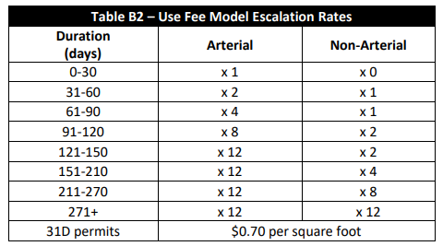
How use fees are calculated – Time in right-of-way
Use fees escalate with time and the rate of escalation varies by street type
The escalation rate is captured by the Rate Start Date (RSD) in Accela
  If a project clears a frontage for a period, the RSD will continue from where it left (it does not reset)
  The RSD for the first 30 days on non-arterial streets is 0, which means no use fees incur
  The higher the RSD, the higher the use fees
  Each street type maxes out at an RSD of 271

Slide 6
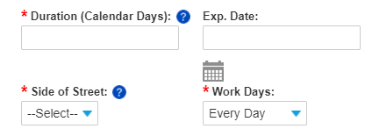
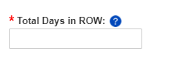
How use fees are calculated – Time in right-of-way
The 2019 use fee methodology replaced the old 10-day increment of tracking time in right-of-way to every day
Currently, we track time in right-of-way with Duration + Work Days
BUT this does not allow projects to easily track work that only impacts the right-of-way for partial weekdays, AND we are not meeting the intent of the use fee methodology
The new way to calculate time in right-of-way will be with the new field Total Days in ROW

Slide 7
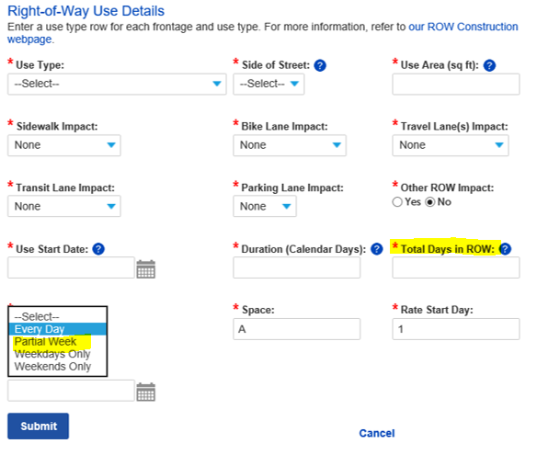
New Total Days in the ROW option to track uses
As of November 18th, you can let us know how many total days you are working in the right-of-way
  News Total Days in ROW field is how many days you will be in the right-of-way
    Used to calculate use fees
    Not required for SIP or ROW Maintenance records
  New Partial Week option under Work Days
    Informational only, no impact on use fees
  Duration is the overall project timeline and will be used to calculate the Use Expiration Date

Slide 8


Total Days in ROW Conversion on Existing Records
Use Fees Calculated with Total Days in ROW
Primary
Review
Issuance
Application
Screening
Issuance
Inspection
Closeout
Review
Evaluation
Prep
Secondary
Review
Secondary
Review
Use Fees Calculated with Duration + Work Days

Slide 9
Total Days in ROW Conversion on Existing Records
For existing records that are not at the Issuance step, a one-time script will calculate the Total Days in ROW using Duration and Work Days
Examples:
Exceptions
  Issued, Withdrawn, Void and Canceled Amendments
  Closed Records
Duration | Workdays | Calculation | Days in ROW
56 | All Days | 56 x 1 | 56
56 | Weekdays Only | 56 x (5/7) | 40
56 | Weekends Only | 56 x (2/7) | 16

Slide 10
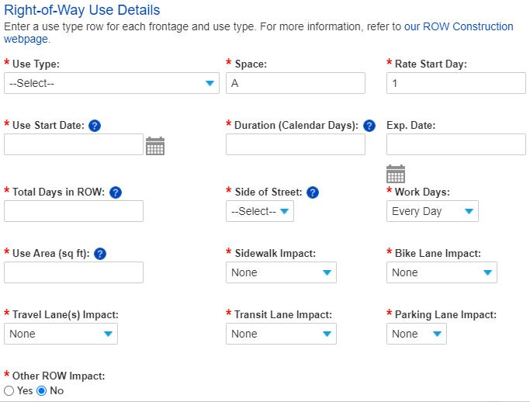
Duration vs. Total Days in ROW
?
Duration: Enter the total number of calendar days needed to complete work in the right-of-way (e.g., if work starts on Monday and ends two weeks later on Thursday, the Duration is 11). This is used to calculate the Use Exp. Date.
Total Days in ROW: Enter the actual number of days you will be using the right-of-way (e.g., if you are using the right-of-way Monday thru Thursday for two weeks, the Total Days in ROW is 8). This number cannot exceed the duration. This is used to calculate use fees.
?

Slide 11
Duration vs. Total Days in ROW
Utility Permits
Duration calculates Use Exp & Permit Exp Dates
Construction Permits
Duration calculates Use Exp Date
Total Days in ROW calculates use fees
Duration = Total Days in ROW
Total Days in ROW calculates use fees
Duration = Project timeline
Can be greater than Total Days in ROW
Total Days in ROW = Working days in ROW
Different approach for utility vs. non-utility permits

Slide 12

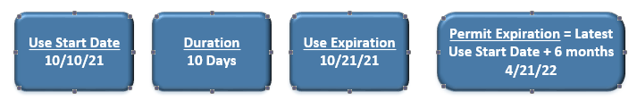

Utility Permit Duration vs. Total Days in ROW Rules
The 6-month permit expiration rules do not change with the new Total Days in ROW field
Initial issuance:
  The Use Expiration = Use Start Date + Duration
  The Permit Expiration = Latest Use Expiration Date + 6-months
Amendment issuance before the Latest Use Expiration Date:
  The Use Expiration = Use Start Date + Duration
  The Permit Expiration = Latest Use Expiration Date + 6-months

Slide 13

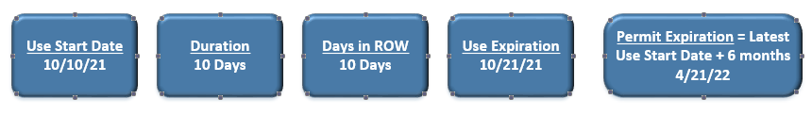
Utility Permit Duration vs. Total Days in ROW Rules
How use fees are calculated are changing with the new Total Days in ROW field
The Duration must match the Total Days in ROW
If the number of days is unknown (10, 12, or 23 etc.):
  Choose the highest possible number of days to avoid costly and timely extension amendments

Slide 14
Utility Permit Duration vs. Total Days in ROW Rules
Duration – Enter the total number of days needed to complete work in the right-of-way (e.g., if work starts on a Monday and ends two weeks later on a Thursday, the Duration is 11).
  This is used to calculate the Use Exp. and Permit Exp. Dates
  The Duration must equal Total Days in ROW
Total Days in ROW – Enter the total number of days that you will be using the right-of-way.
  This is used to calculate use fees
  This number must equal Duration
  This number must be greater than zero

Slide 15
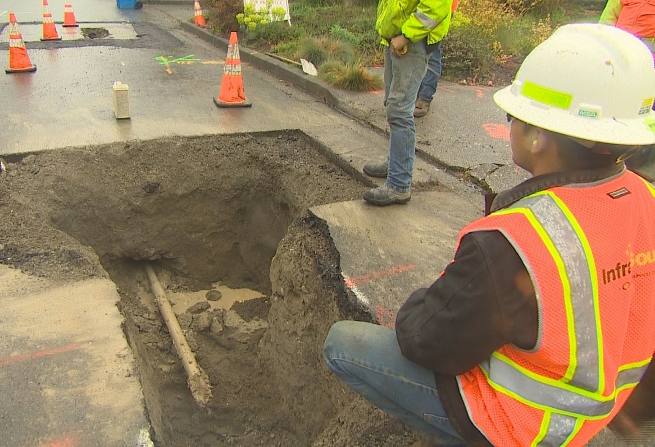
Utility Permit Duration vs. Total Days in ROW Rules - Examples
Example 1: Gas line installation
Project timeline is 4 months
Project requires intermittent street closures for a total of 18 days for installation and restoration phases
Right-of-way is clear outside construction days
Duration = 18 days
Total Days in ROW = 18 days
Use Expiration Date = Start Date + Duration (18 days)
Permit Expiration Date = Latest Start Date + 6 months
Notes:
Job Start reschedules must be 2 business days in advance

Slide 16
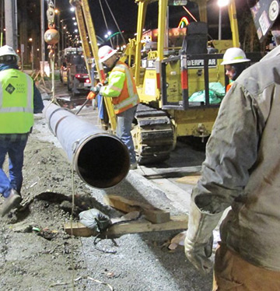
Utility Permit Duration vs. Total Days in ROW Rules - Examples
Example 2: Gas main line installation
Project timeline is 10 months
Project requires street closures for a total of 46 days for installation and restoration phases
Right-of-way is clear outside construction days
Duration = 46 days
Total Days in ROW = 46 days
Use Expiration Date = Start Date + Duration (46 days)
Permit Expiration Date = Latest Start Date + 6 months
Notes:
Job Start reschedules must be 2 business days in advance

Slide 17
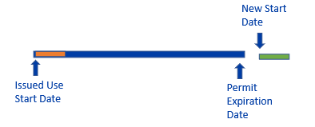
Utility Permit Extension Amendment Rules
Scenario 1: Work is taking place after the Permit Exp. Date
Existing Use Line:
Initial Total Days in ROW = 6 days
Initial Duration = 6 days
Use Expiration Date = Initial Start Date + Duration (6 days)
Permit Expiration Date = Latest Use Start Date + 6 months
Extended Use Line:
Additional Total Days in ROW = 8 days
New Duration = 8 days
New RSD = 7
New Use Expiration Date = New Start Date + Duration (8 days)
New Permit Expiration Date = Latest Use Start Date + 6 months
Requires an Extension Amendment
Duration = Days in ROW
Notes:
Job Start reschedules must be 2 business days in advance

Slide 18
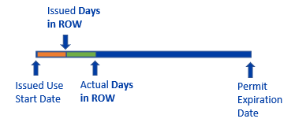
Utility Permit Revision Amendment Rules
Scenario 2: Work is extending beyond issued Days in ROW date within the original Permit Exp. Date
Existing Use Line:
Space = A
Initial Total Days in ROW = 22 days
Initial Duration = 22 days
Use Expiration Date = Initial Start Date + Duration (22 days)
Permit Expiration Date = Latest Use Start Date + 6 months
New Use Line:
Space = B
Initial Duration = 22 if the Start Dates are the same
Additional Total Days in ROW = 15 days
RSD will need to be manually updated based on when the impacts began
Use Expiration Date = Same as Initial Issuance if the Start Dates are the same
Permit Expiration Date = Same as Initial Issuance if the Start Dates are the same
An Extension Amendment forces a new Start Date after the Use Expiration Date
To add more days within an existing timeframe, an additional use line will need to be added through a Revision Amendment
Notes:
Job Start reschedules must be 2 business days in advance

Slide 19



Construction Permit Duration vs. Total Days in ROW Rules
The Total Days in ROW should be actual days they will be in the right-of-way
If the number of days is unknown (1, 2, or 3 etc.):
  Choose the highest possible number of days to avoid costly and timely extension amendments
The Duration is capturing project timeline independent of number of days you’ll be in the right-of-way
Having a longer Duration does not allow the project to be in the right-of-way beyond the number of Total Days in ROW

Slide 20
Construction Permit Duration vs. Total Days in ROW Rules
Duration – Enter the total number of calendar days needed to complete work in the right-of-way (e.g., if work starts on a Monday and ends two weeks later on a Thursday, the Duration is 11).
  This is used to calculate the Use Exp. Date.
  The Duration can be greater than Total Days in ROW
Total Days in ROW – Enter the actual number of days that you will be using the right-of-way (e.g., if you are using the right-of-way Monday through Thursday for two weeks, the Total Days in ROW is 8).
  This is used to calculate use fees
  This number cannot exceed Duration
  This number must be greater than zero

Slide 21
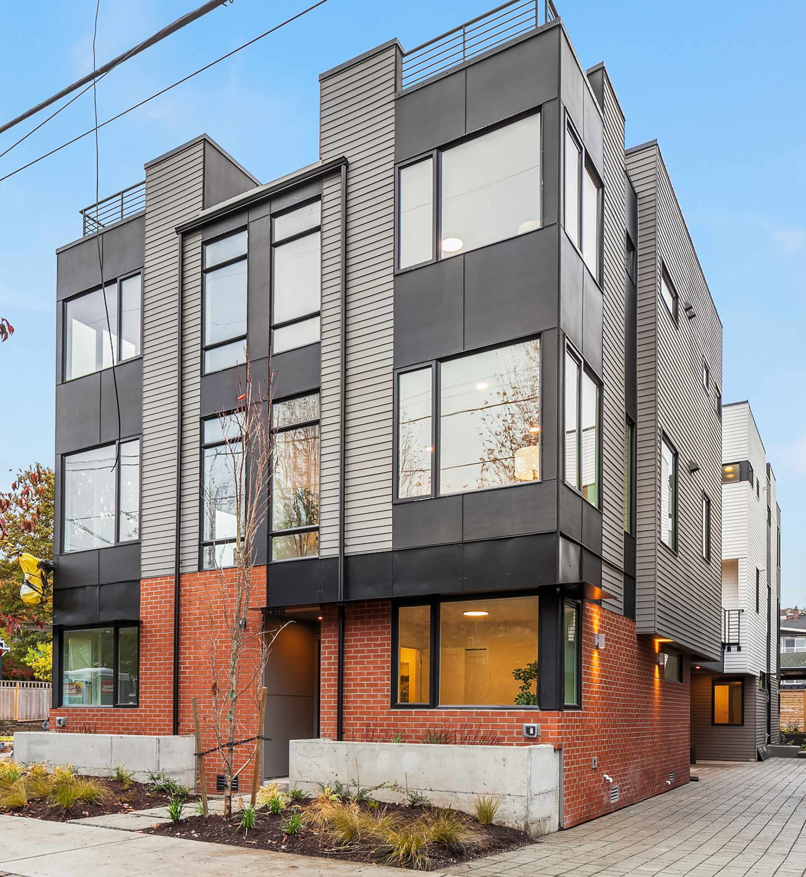
Construction Permit Rules - Examples
Example 1: Townhouse project on a non-arterial street
Project timeline is 6 months
Project requires intermittent material deliveries 2-3 days a week
Right-of-way is clear outside delivery days
Duration = 185 days (26 weeks)
Total Days in ROW = 78 days (3x26 weeks)
Use Expiration Date = Start Date + Duration (185 days)
Notes:
Job Start reschedules must be 2 business days in advance

Slide 22

Construction Permit Rules - Examples
Example 2: Office Building in an Urban Village
Project timeline is 18 months
Project requires a sidewalk and parking lane closure 7 days a week
Peds are rerouted to the parking lane on the weekends
Sidewalk Closed Use Line:
Duration = 556 days (79 weeks)
Total Days in ROW = 556 days
Use Expiration Date = Start Date + Duration (556 days)
Parking Lane Closed Use Line:
Duration = 556 days (79 weeks)
Total Days in ROW = 395 days (5*79 weeks)
Use Expiration Date = Start Date + Duration (556 days)
Parking Lane Rerouted Use Line:
Duration = 556 days (79 weeks)
Total Days in ROW = 158 days (2*79 weeks)
Use Expiration Date = Start Date + Duration (556 days)
Notes:
Job Start reschedules must be 2 business days in advance

Slide 23
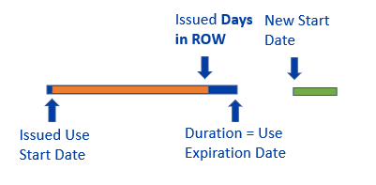
Construction Permit Extension Amendment Rules
Scenario 1: Work is taking place after the Use Exp. Date
Existing Use Line:
Initial Total Days in ROW = 62 days
Initial Duration = 78 days
Initial Use Expiration Date = Initial Start Date + Duration (78 days)
Extended Use Line:
Additional Total Days in ROW = 18 days
New Duration = 20 days
New RSD = 63
New Use Expiration Date = New Start Date + Duration (20 days)
Notes:
Job Start reschedules must be 2 business days in advance

Slide 24
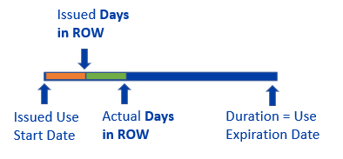
Construction Permit Revision Amendment Rules
Scenario 2: Work is extending beyond issued Days in ROW date within the original Use Exp. Date
Existing Use Line:
Space = A
Initial Total Days in ROW = 20 days
Initial Duration = 78 days
Use Expiration Date = Initial Start Date + Duration (78 days)
New Use Line:
Space = B
Duration = 78 if the Start Dates are the same
Additional Total Days in ROW = 15 days
RSD will need to be manually updated based on when the impacts began
Use Expiration Date = Same as Initial Issuance if the Start Dates are the same
An Extension Amendment forces a new Start Date after the Use Expiration Date
To add more days within an existing timeframe, an additional use line will need to be added through a Revision Amendment
Notes:
Job Start reschedules must be 2 business days in advance

Slide 25
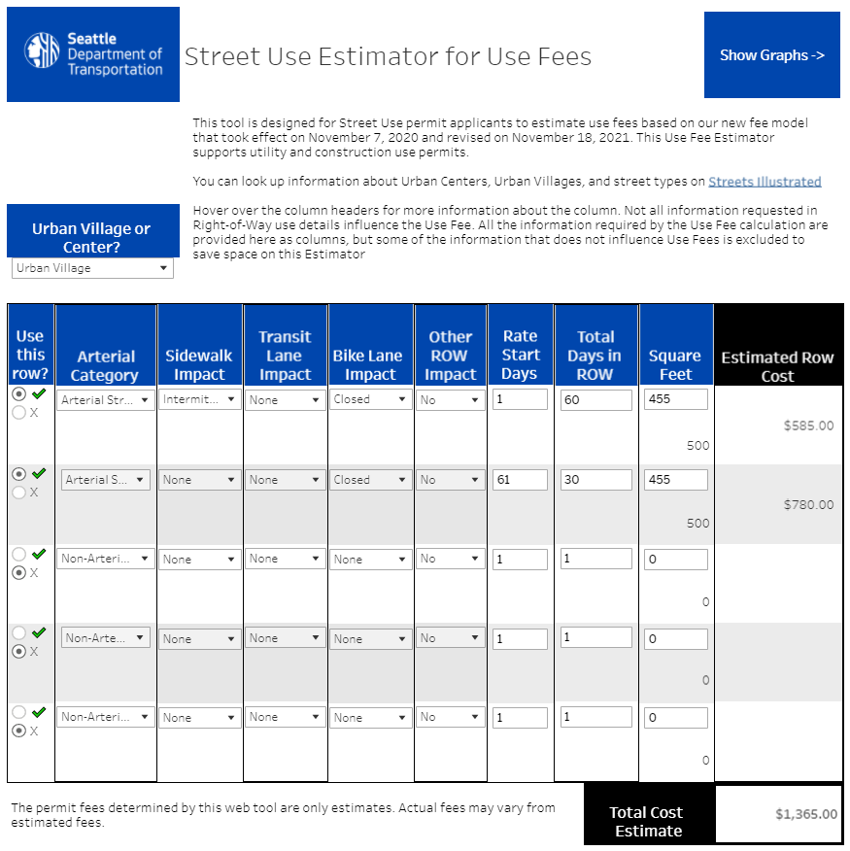
Updated
Use Fee Calculator to estimate use fees for your project

Slide 26
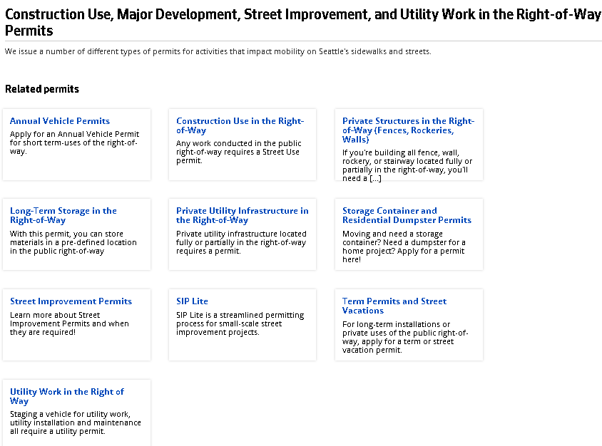
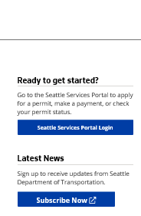
How to get help on our websites
Our websites have been updated to walk you through the process
You can also find a link to the Seattle Services Portal on the right panel of every website
http://www.seattle.gov/transportation/permits-and-services/permits
Access to the Portal can be found on the right panel of every webpage
To stay informed on Street Use updates, you can sign-up to receive our monthly newsletter

Slide 27
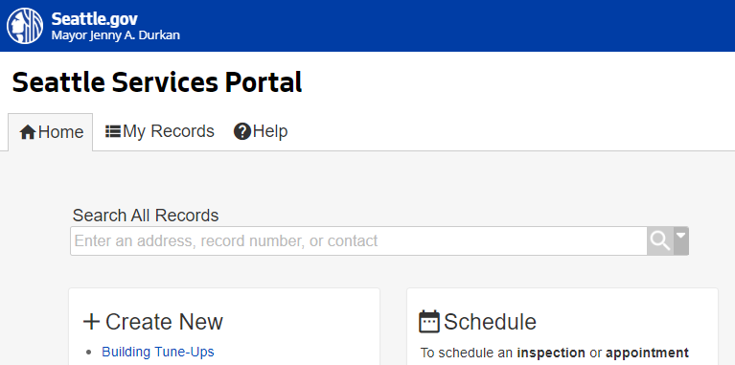
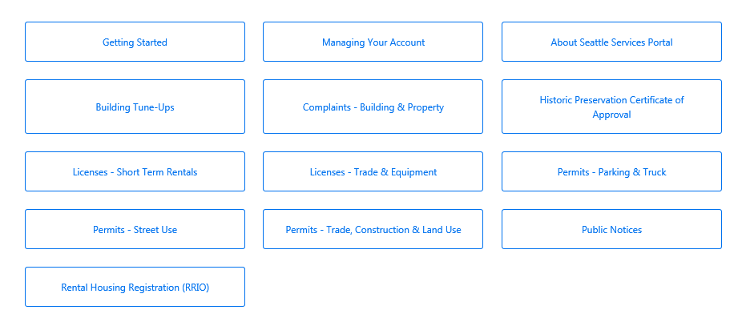
How to get help on the SSP Help Center
You can find many help articles on how to navigate the Seattle Services Portal from the Help Center
Get familiar with these three sections:
    Getting Started
    Managing Your Account
    Permits - Street Use
2
Notes:
When a user needs help, they can access the Help Center articles by clicking on Help.
The banner is available throughout the portal, and Help can be accessed at any time simply by clicking on the Help button.

Slide 28
How to get help if you can’t find the answer
Email dot_su_ssportal_questions@seattle.gov for:
  General Seattle Service Portal navigation
  Contact cleanup or fix needs
  Help on responding to Corrections, uploading documents, scheduling inspections etc.
  If you think an error has occurred in the Seattle Services Portal
Email dot_permits@seattle.gov for:
  Request virtual 1x1 coaching with a reviewer
  General inquiries and coaching
  Contact changes for permits or amendments in process
  Application changes for unassigned records
  Fee disputes
Email SeattleServices_ITHelp@seattle.gov for Seattle Services Portal account issues

Slide 29
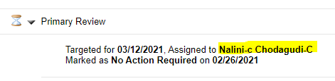
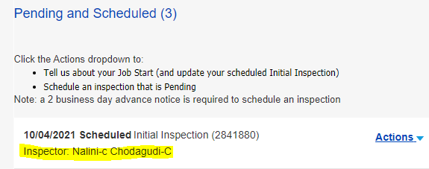
How to get help
Where to find the assigned reviewer on the Status tab
Email the assigned reviewer for:
  Application changes for permits or amendments in process
  Corrections required response clarification on
  Permit status inquiries outside the posted permit timelines
Email the assigned inspector for:
  Job start changes after the Initial Inspection has passed
  Inspection questions including notification, inspection results etc.
  Scheduling an on-site meeting
Where to find the assigned inspector on the Inspections tab

